Slide 1
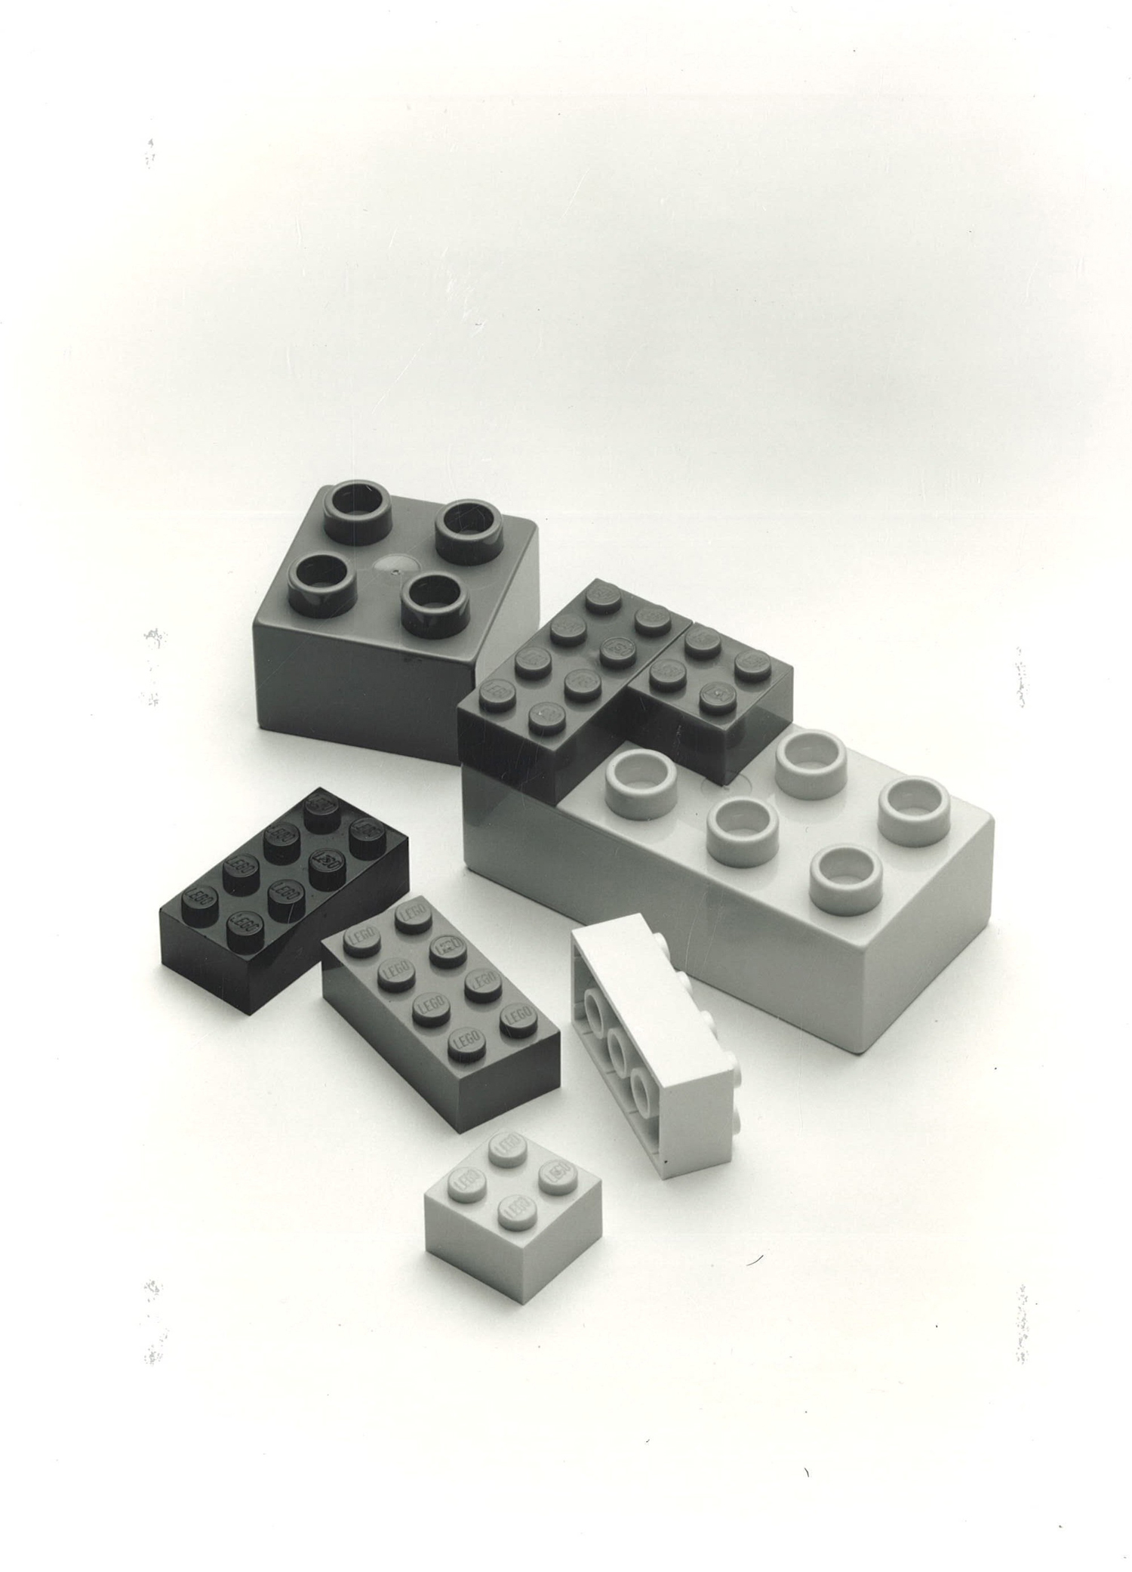
A Recognized
LEGO® Fan Community
- The New Engagement Model

Slide 2
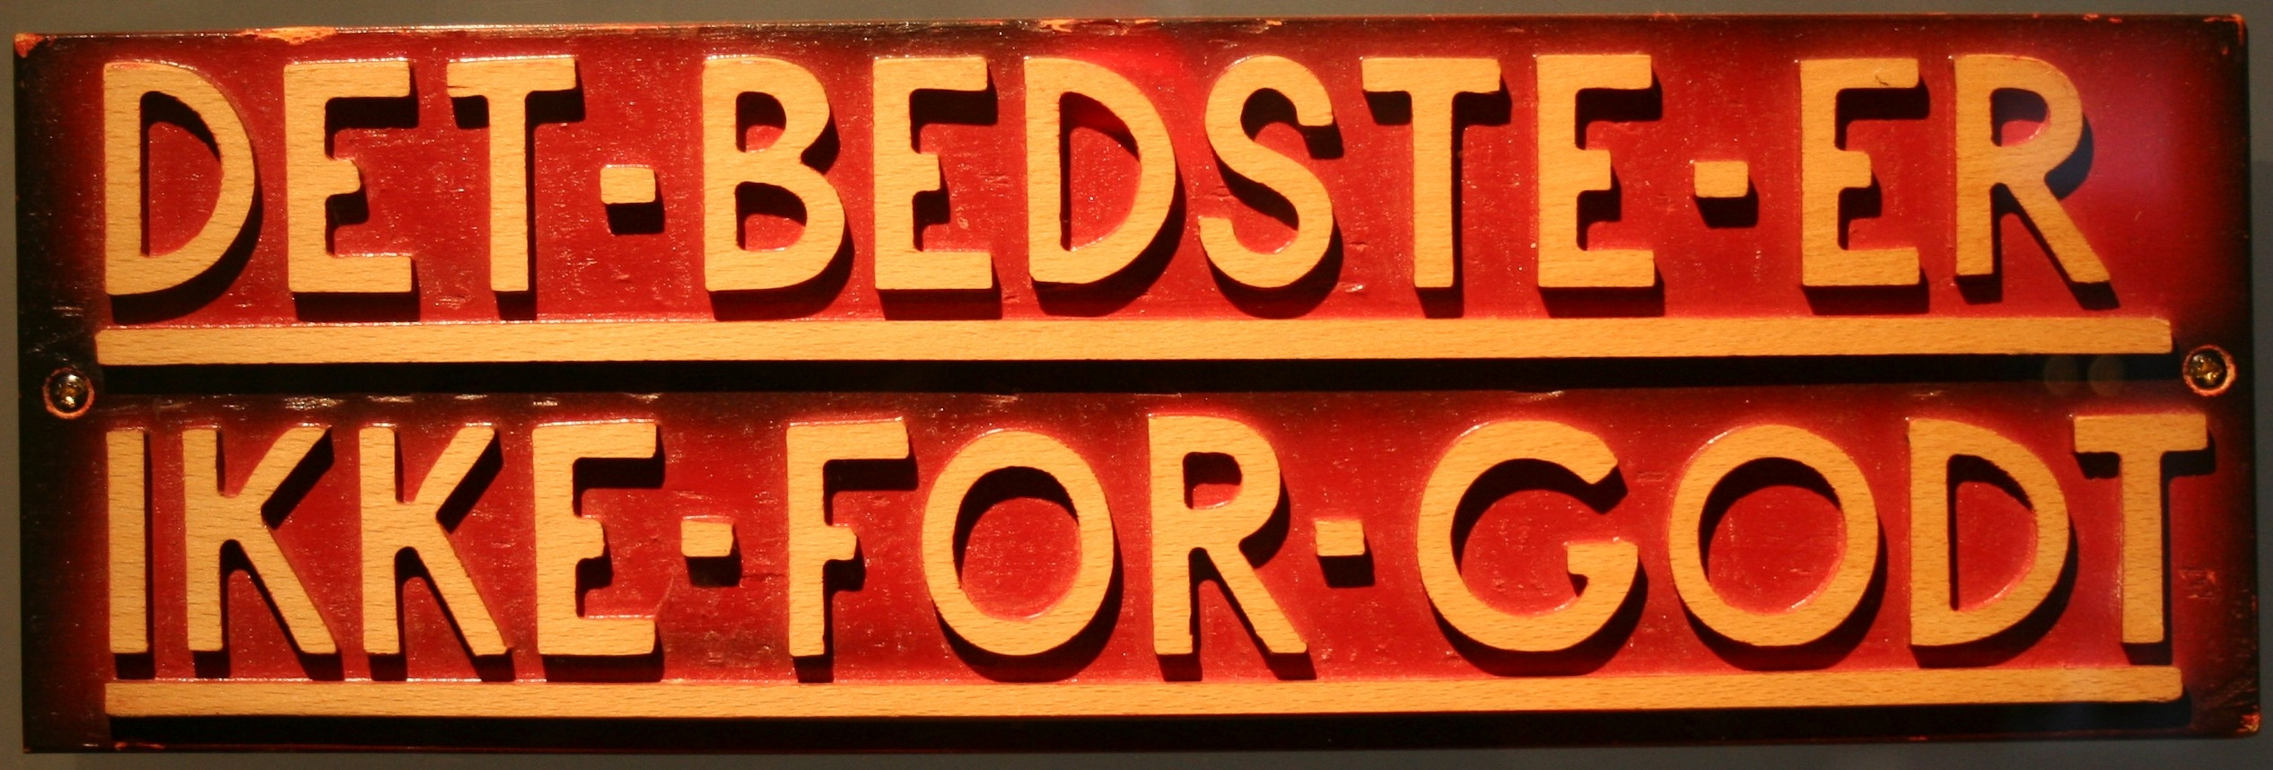
Welcome
Dear Ambassadors,
Since 2008, the LEGO Community Team has systematically engaged with the amazing TFOLs and AFOLs globally. Over these years the Fan Community has grown, not only in size, but in its ability to inspire and develop builders of all ages. This has in part been accomplished by implementing and sharing new ideas and view points, as well as presenting incredible MOCs. The LEGO Group truly values this shared passion for our brand and work done in order to support our mission globally. The endless creativity in the Fan Community has taken the LEGO Brick and the LEGO System of Play to the max, thus challenging the LEGO Group to be at its best at all times!
A new Recognition program! In order to continually provide the most valuable support to you, the Fan Community, we have designed a new Recognition program. This program has been adjusted to fit both the growth of the Fan Community as well as the different levels of ambition and desire in the Fan Community by applying a tiered approach. This tiered approach will allow LCE to better engage and support the individual needs of each community, in other words put the most effort where it has the biggest impact on the community.
Page 2

Slide 3
Index
Slide 2 Welcome
Slide 4 The different types of Recognized Communities we support
Slide 5 Engagement model introduction
Slide 11 Evaluation criteria
Slide 12 Support offerings – General
Slide 14 Support offerings – RLUG
Slide 15 Support offerings – RLFM
Slide 16 Support offerings – RLOC
Slide 17 Ambassador and community requirements and responsibilities
Page 3

Slide 4
The different types of Recognized Communities we support
RLUGs – Recognized LEGO® User Groups
The LEGO User Groups typically has physical presence in a limited geographical area (for example a country or state). The members organize events, get together for build meetings and do local community work. The LUG may or may not collaborate with the local LEGO Business Unit.
RLOCs – Recognized LEGO® Online Communities
The Online Communities are present online mainly and do most of their community activities via their online forums in which they drive discussions, product reviews, competitions and everything else celebrating the LEGO Brand.
RLFMs – Recognized LEGO® Fan Media
The Fan Media are outlets such as physical Magazines, online Magazines, Blogs, YouTube channels, etc. They focus on LEGO History, LEGO Product Reviews, LEGO News and produce articles focusing on everything relating to the LEGO Brand.
In the following pages, we introduce the engagement model as well as provide you with an understanding of the benefits and requirements for being a Recognized LEGO Community.
Page 4

Slide 5
Engagement model introduction
Tier 1-2 applies to all existing and future recognized communities (RLUG, RLFM, RLOC)
To enable successful onboarding, any newly recognized community will spend the first year in tier 1, regardless of any previous accomplishments.
The model is an organic model. Over time we’d like communities to grow and improve, but it needs to be at their own pace and at a level they are comfortable with.
Each Tier is a destination in itself and shifting between tiers is a natural part of the model.
Tier 0 Spark
Tier 1 Stable
Tier 2 Lead
Tier 0 applies to all existing communities with the potential to become recognized
Notes:
During presentation of this slide, remember to address tier assignment during transition

Slide 6
Tier 0 - Spark
This tier sits outside the recognized communities.
They come in all shapes and forms. They can be new as well as “old” groups.
The main focus for the AFOL Engagement team is to spark interest by generating awareness, enthusiasm, and motivation to seek recognition.
Tier 0 Spark
Generating awareness
Sparking interest

Slide 7
Tier 1 - Stable
Tier 1 is a strong, long-term tier in its own right.
The LEGO Group’s involvement with this tier focuses on establishing and stabilizing recognized group’s connection to the values, mission, and culture of the Recognized LEGO® Fan Community Program.
Tier 1 groups are represented by an Ambassador who acts as contact point between the LEGO Group and the group.
Tier 1 groups are committed to the LEGO hobby and community. Physical activities and events are mainly locally oriented, or of a specific nature.
Like all recognized groups they are curious about the larger and global community of LEGO fans.
Joining a culture
Learning norms
Stabilizing
Tier 1 Stable

Slide 8
Tier 1 Stable
To provide a better understanding of what a typical Tier 1 Community looks like, please see below.
Recognized LEGO User Group
(RLUG)
Recognized LEGO Fan Media
(RLFM)
Recognized LEGO Online Community (RLOC)
Has 20-50 active members who meet on a regular basis
Organizes locally oriented public events
Has a basic organizational structure
Utilize support offerings for RLUG initiatives
Do not share leaks and confidential information
Ambassador actively participates in discussions and topics and shares experience and learnings on LAN
Locally oriented
Publish weekly posts and has a steady flow of traffic
Share announcements and press releases coming from the LEGO Group and its partners
Do not share leaks and confidential information
Ambassador actively participates on LAN in discussions and topics and shares experience and learnings
Locally oriented by language and/or interest
Activities and reach with local impact and participation
Forum traffic mirrors activities and is perceived as valuable by the Community
Do not share leaks and confidential information
Ambassador actively participates on LAN in discussions and topics and shares experience and learnings

Slide 9
Tier 2 - Lead
The LEGO Group’s involvement with this tier focuses on maintaining and growing recognized group’s connection to the values, mission, and culture of the LEGO Community Program.
Tier 2 groups are represented by an Ambassador who acts as contact point between the LEGO Group and the group.
Tier 2 groups lead by example and generate new ideas that renew and grow the community. They share those ideas on LAN and execute them via events, conventions and other activities.
Activities extend far beyond their circle of members/subscribers potentially with a global impact.
Tier 2 groups’ have a structured approach to actively recruiting new members and growing their reach.
Driving a culture
Exemplifying norms
Scaling and teaching
Pulling up the ecosystem
Tier 2 Lead

Slide 10
Tier 2 Lead
To provide you with a better understanding of what a typical Tier 2 Community looks like, please see below.
Recognized LEGO User Group
(RLUG)
Recognized LEGO Fan Media
(RLFM)
Recognized LEGO Online Community (RLOC)
Has 50+ active members who meet monthly
Organizes public events with a big community reach
Has a well established organizational structure to support different RLUG activities
Utilize support offerings for RLUG initiatives
Do not share leaks and confidential information
Ambassador actively participates on LAN in discussions and topics and shares experience and learnings
Regional to global orientation
Several posts and articles per week
Has a solid flow of traffic
Share announcements and press releases coming from the LEGO Group and its partners
Do not share leaks and confidential information
Ambassador actively participates on LAN in discussions and topics and shares experience and learnings
Make reviews of upcoming LEGO products adhering to briefing
Regional to global orientation
Regular activities and good regional to global reach and participation
Solid forum traffic
Ambassador actively participates on LAN in discussions and topics and shares experience and learnings
Make reviews of upcoming LEGO products adhering to briefing

Slide 11
Evaluation Criteria Throughout the year we evaluate the success of Recognized communities based on the criteria below. we will move recognized communities up or down in tier based on the evaluation.
Presence [Reach, local, regional, global]
Activities [LAN, Meetings, Events, Competitions, etc.]
Value Creation [Subscribers, Visitors, Participants, Members, etc.]
Compliance [Recognized community IP guidelines, Fair play policy, novelty confidentiality guideline and Brand guidelines]
Structure [Ambassador, second point of contact, data reporting, recruitment, etc.]
Engagement [Local markets, other ambassadors/communities, event participation, LAN, etc.]
Page 11

Slide 12
Support Offerings
The support offered to the recognized community intends to support activities that inspire others, such as building meetings, reviews, events, online reviews, competitions, articles, projects, etc. But just as important, to build relationships in the community as well as with the LEGO Group. Below is an overview of the benefits that come with being recognized.
All Recognized communities have access to The LEGO® Ambassador Network, a major advantage that comes with the opportunity to interact with the LEGO Group and with more than 250 ambassadors, representing more than 600.000 AFOL and TFOL members in the Community. Because of the huge benefit of sharing your knowledge and ideas, being recognized also comes with a requirement to participate and contribute to the LAN.
Access to early press releases.
Involvement in LEGO® internal projects related to product development, program development, etc.
Participation in Fan Media day Billund and Fan Media meet n’greet day in Enfield.
LEGO sets and elements for event support, project support, LUGBULK, online activities, annual support package, (overview on the following page).

Slide 13
Brick support offerings overview
Tier 1 Stable
Tier 2 Lead
LUGBULK
Annual Support
Event Support
Project Support
! All support is subject to availability

Slide 14
In order to provide you with a clear understanding of the brick support offerings through out the year for a Recognized LEGO User Group please see below tiered descriptions
RLUG
Tier 2
Tier 1
Tier 2
Annual Support Package containing 1 LEGO Set Box (assortment of LEGO sets), 1 Activity Box and 2 Play Brick Boxes
The opportunity to apply for up to 2 events via the Event Support Program
Press Releases
LUGBULK participation
Project Support
Annual Support Package containing 2 LEGO Set Boxes (assortment of LEGO sets), 2 Activity Box and 4 Play Brick Boxes
The opportunity to apply for up to 5 events via the Event Support Program
Press Releases
LUGBULK participation
Project Support
Invitations to participate in TLG internal workshops
Invitations to participate in TLG marketing activities
Support program details are available on the LAN

Slide 15
In order to provide you with a clear understanding of the support offerings through out the year for a Recognized LEGO Fan Media please see below tiered descriptions
RLFM
Tier 1
Tier 1
Tier 2
The opportunity to apply for up to 2 events via the Event Support Program
The opportunity to request up to 3 online activities and/or reviews to be supported
Press Releases
LUGBULK participation
Project Support
The opportunity to apply for up to 5 events via the Event Support Program
The opportunity to request up to 4 online activities.
The opportunity to request up to 6 reviews to be supported.
Press Releases
LUGBULK participation
Project Support
Fan Media Day/ Meet n’greet invitation
Invitations to participate in TLG internal workshops
Invitations to participate in TLG marketing activities
Support program details are available on the LAN

Slide 16
In order to provide you with a clear understanding of the support offerings through out the year for a Recognized LEGO Online Community please see below tiered descriptions
RLOC
Tier 1
Tier 2
Annual Support Package containing 1 LEGO Set Box
The opportunity to apply for up to 2 events via the Event Support Program
The opportunity to request up to 3 online activities and/or reviews to be supported
Press Releases
LUGBULK participation
Annual Support Package containing 2 LEGO Set Box
The opportunity to apply for up to 5 events via the Event Support Program
The opportunity to request up to 6 online activities and/or reviews to be supported
Press Releases
LUGBULK participation
Project Support
Invitations to participate in TLG internal workshops
Invitations to participate in TLG marketing activities
Support program details are available on the LAN

Slide 17
Ambassador and community requirements and responsibilities
An Ambassador of a Recognized community must be 18+ and appointed by the community to represent the community and its members actively on the LAN. The Ambassador does not represent The LEGO Group.
The Ambassadors primary responsibilities are:
To be the single point of contact between the LEGO Group and the community he/she represents.
To bring forward relevant topics raised in the community to the LAN in order for everyone to benefit from the experience of the other Ambassadors.
Take information from the LAN to the community members.
To ensure that all formal requirements related to reporting, sign up for support, etc. are met.
To actively engage and participate on the LAN.
To distribute and/or participate in surveys that are generated by the LEGO Group.
To keep the LAN team updated on any changes to the community, be it address changes, change in Ambassador, structure, inability to meet requirements or other relevant information.
Page 17

Slide 18
Roles and Responsibilities
To maintain recognized state, the RLUG/RLFM/RLOC must meet the following requirements:
The Ambassador must fulfil her/his role and responsibilities as outlined in this document
Activity reports must be submitted in time
Comply with TLG Fair Play policy and TLG Brand Values
Comply with the Novelty confidentiality policy
Comply with the IP Guidelines
Engage the AFOL Community and The LEGO Group in a positive and respectful manner
Plan and drive activities of value to and impact on the AFOL Community
To ensure an optimal relationship and interaction between the Ambassadors and the LEGO Group, each Ambassador is expected to act in a constructive and respectful manner and be in all actions and activities a role model for other Ambassadors as well as members.
It is considered a breach of agreement if responsibilities cannot be met or an unacceptable behavior is demonstrated by the Ambassador or the RLUG/RLFM/RLOC and the LEGO Group will review the status of the Ambassador, or the RLUG/RLFM/RLOC
Failure to meet the above requirements to maintain recognized state or behavior may result in loss of recognition, support and participation in the LAN.
The exclusion may lead to the RLUG/RLFM/RLOC being asked to elect a new Ambassador to represent them but it may also lead to the RLUG/RLFM/RLOC being excluded as well.
Exclusion can happen with no prior warning.

